Slide 1

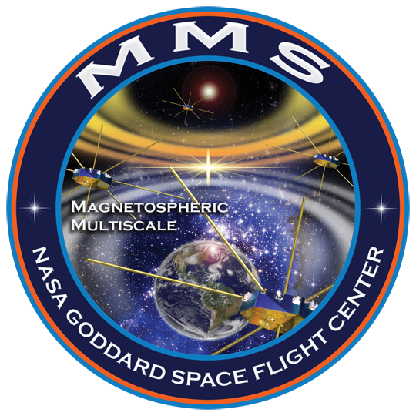
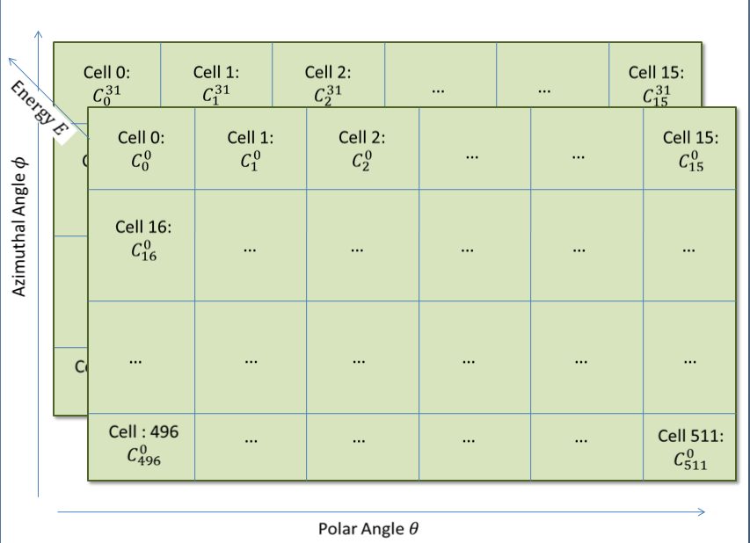
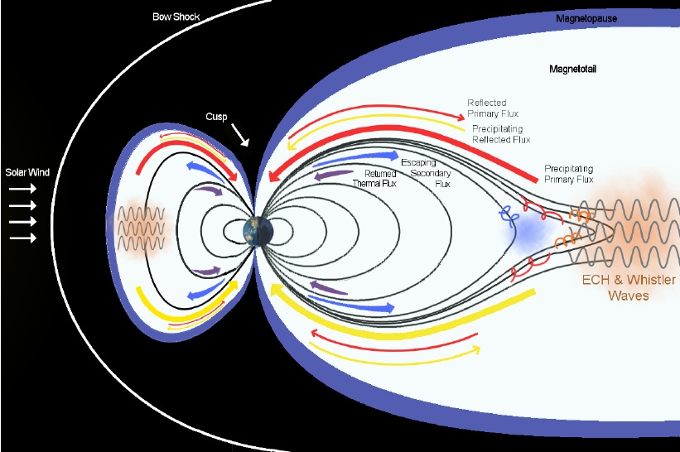
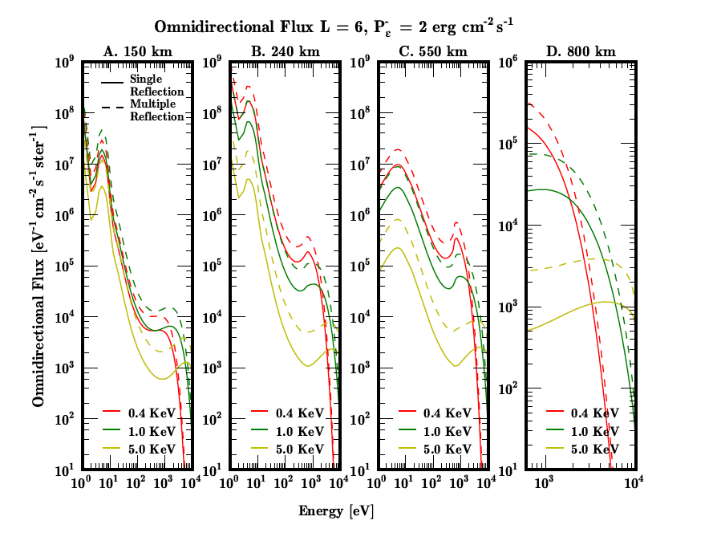
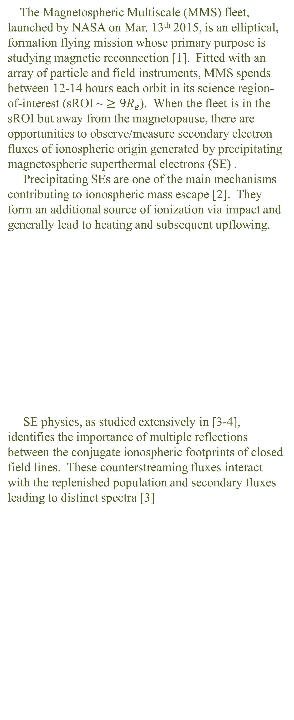

Differential Electron Flux Spectra Measured by the Magnetospheric Multiscale Mission Show Strong Field-aligned Electron Population of Ionospheric Origin
Conrad Schiff¹ (Conrad.Schiff-1@nasa.gov), George Khazanov¹, Barbara L. Giles¹, Levon A. Avanov^{1,2}, J.L. Burch³,V.N. Coffey⁴, J.C. Dorelli¹, D. Gershman^{1,2}, B. Lavraud⁵, T. E. Moore¹, W.R. Paterson¹, C.J. Pollock⁶,C.T.Russell⁷,Y. Saito⁸, J.-A. Sauvaud⁵,R.J. Strangeway⁷ |¹NASA Goddard Space Flight Center, Greenbelt, MD, ²University of Maryland, College Park, MD, ³Southwest Research Institute, San Antonio, TX, ⁴NASA Marshall Space Flight Center, Huntsville, AL, ⁵Research Institute in Astrophysics and Planetology, Toulouse, France, ⁶Denali Scientific, Healy, AK, ⁷University of California, Los Angeles, CA, ⁸Institute for Space and Astronautical Science, Sagamihara, Japan
SM21A-2445
Background
Results
Motivation and Context
Data Analysis and Methodology
FPI electron skymaps consist of measured counts distributed over 512 cells ($I=0…511$; 32 azimuth ($φ$) $×$ 16 polar angles ($θ$)) over 32 energies [5]
Each cell has a look direction ${\hat{n}}_{I}(φ,θ)$ with a corresponding flow direction ${\hat{v}}_{I}=−{\hat{n}}_{I}$
Magnetic field in the instrument frame ${\vec{B}}_{DBCS}$ used to construct pitch angle distribution for each cell, $α_{I}=\cos^{−1}\left({\hat{v}}_{I}⋅{\vec{B}}_{DBCS}\right)$
Considered error sources: a) Spacecraft potential, b) Instrument-generated photoelectrons, c) Poisson-noise/counting statistics
Magnetic Field
GSM Fieldline
Trace
Flux Spectrum by Pitch Angle
Excess Flux:
Sunlit - Shadowed
The Magnetospheric Multiscale (MMS) fleet, launched by NASA on Mar. 13th 2015, is an elliptical, formation flying mission whose primary purpose is studying magnetic reconnection [1]. Fitted with an array of particle and field instruments, MMS spends between 12-14 hours each orbit in its science region-of-interest (sROI ~ $≥9R_{e}$). When the fleet is in the sROI but away from the magnetopause, there are opportunities to observe/measure secondary electron fluxes of ionospheric origin generated by precipitating magnetospheric superthermal electrons (SE) .
Precipitating SEs are one of the main mechanisms contributing to ionospheric mass escape [2]. They form an additional source of ionization via impact and generally lead to heating and subsequent upflowing.
SE physics, as studied extensively in [3-4], identifies the importance of multiple reflections between the conjugate ionospheric footprints of closed field lines. These counterstreaming fluxes interact with the replenished population and secondary fluxes leading to distinct spectra [3]
Aug 04, 2015 538
Oct 26, 2015 0
Data analyzed during stable magnetic field conditions when the observatory sits in the magnetosphere on closed filed lines (columns 1 and 2)
Collecting data into discrete bins provides survey spectra (column 3) and excess spectra between sunlit and shadowed conjugate footprints (column 4).
Mar 02, 2016 600
Conclusions & Future Work
References
[1] Fuselier et al. (2016), Space Science Reviews 199
[2] Moore et al. (2010), J. Geophys Research 115.
[3] Khazanov et al. (2013), J. Geophys Research 119
We present experimental observations of binned pitch angle distributions and excess secondary flux between sunlit and shadowed conjugate points for 3 survey cases distributed in the magnetosphere
Each magnetic field configuration gives a unique signature that will inform the identification of the appropriate wave-particle interaction (e.g. ECH, Whistler Chorus, etc.) that scatters plasma sheet electrons into the precipitating population
Improvements in correcting for instrument-generated photoelectrons is needed to improve knowledge of low-energy electron distributions in the counter-streaming fluxes
[4] Khazanov et al. (2015), J. Geophys Research 120
[5] Pollock et al., (2016), Space Sci. Rev., 199
Acknowledgements
The lead author would like to gratefully acknowledge the opportunity afforded by and the patience and support of George Khazanov, Barbara Giles, and Levon Avanov and the professionalism and dedication of the MMS Flight Dynamics, FIELDs, and (especially) Fast Plasma Investigation Teams.

